Slide 1
DTS207TC Database Development and Design
Lec 13 Review
Di Zhang, Autumn 2025
Notes:
I am very happy to have the opportunity to meet with you all in this course.

Slide 2
Outline
Review of BPlus-Tree
Review of Transaction

Slide 3
Three Core Index Structures
Sorted Array
Tree-based Index
Hash-based Index

Slide 4
Sorted Array Index
Data Structure
  Stores data ordered by key value (e.g., ascending)
  Typically implemented using arrays
Operation Complexity
  Search: O(log n) — binary search
  Insert/Delete: O(n) — requires shifting elements
Advantages
  Efficient for range queries
  Compact storage, cache-friendly
Disadvantages
  High update cost
  Static structure, requires pre-allocated space
Use Cases
  Read-only or rarely updated data
  Frequent range queries required

Slide 5
Tree-based Index (e.g., B+ Tree)
Data Structure
  Multi-way balanced search tree
  Leaf nodes form a sorted linked list
Operation Complexity
  Search/Insert/Delete: O(log n)
  Tree height is usually small (3–4 levels)
Advantages
  Supports efficient range queries (via leaf node list)
  Dynamically balanced, suitable for frequent updates
  Supports partial match queries
Disadvantages
  Higher storage overhead (pointers, etc.)
  May involve more random I/O
Typical Applications
  Default database index (e.g., MySQL InnoDB)
  File system indexing

Slide 6
Hash-based Index
Data Structure
  Hash table + buckets
  Hash function maps keys to buckets
Operation Complexity
  Average case: O(1) — direct access
  Worst case: O(n) — all keys collide to one bucket
Advantages
  Extremely fast for equality queries
  Simple and efficient
Disadvantages
  Does not support range queries
  Hash function design is critical
  Dynamic resizing can be costly
Use Cases
  Equality-only queries
  In-memory databases or caches
  Join operations (hash join)

Slide 7
Comparison Summary
Feature | Sorted Array | Tree (B+ Tree) | Hash
Search Complexity | O(log n) | O(log n) | O(1)
Insert/Delete Complexity | O(n) | O(log n) | O(1)
Range Queries | Excellent | Excellent | Not Supported
Equality Queries | Good | Good | Very Fast
Update Friendliness | Poor | Good | Good
Storage Overhead | Low | Medium | Variable
Typical Applications | Static datasets | General-purpose database indexing | In-memory tables, caches

Slide 8
Problem Context
Core Challenges:
  Increasing data volume → Need for efficient data structures
  High disk I/O cost → Reduce disk access frequency
  Dynamic data operations → Maintain balance and performance
Evolution Drivers:
  Balance maintenance
  Disk access optimization
  Range query support

Slide 9
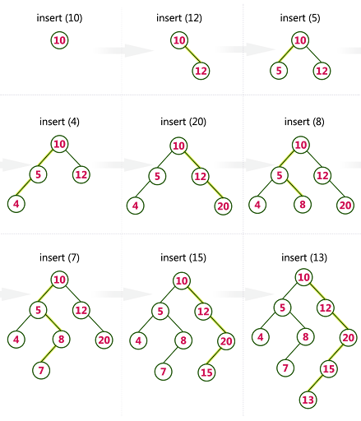
Binary Search Tree (BST)
Basic Structure
Property: Left subtree < Node < Right subtree
Insert Operation
Steps:
  Start comparison from root node
  If less than current node → Go to left subtree
  If greater than current node → Go to right subtree
  Find empty position → Insert new node
Complexity:
  Best: O(log n) (when balanced)
  Worst: O(n) (degenerates to linked list)

Slide 10
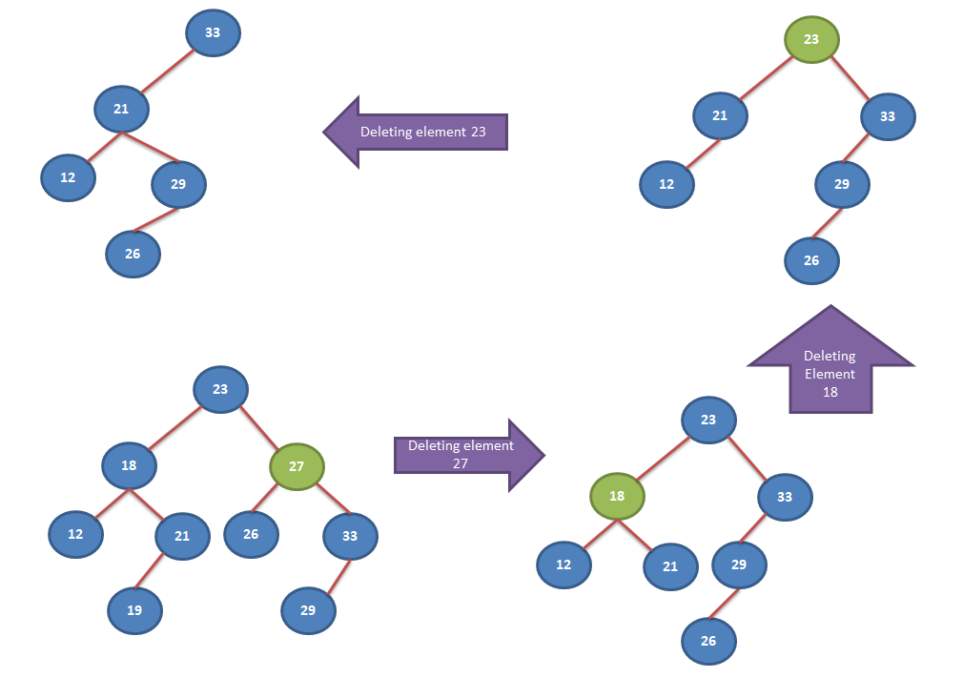
Delete Operation
Three Cases:
  Leaf node: Direct deletion
  One child node: Replace with child node
  Two child nodes:
    Find minimum node in right subtree
    Replace the node to be deleted
    Delete the minimum node from right subtree
Complexity: O(h), where h is tree height
BST Problems
  May degenerate into linked list (O(n) operations)
  Imbalance leads to performance degradation

Slide 11
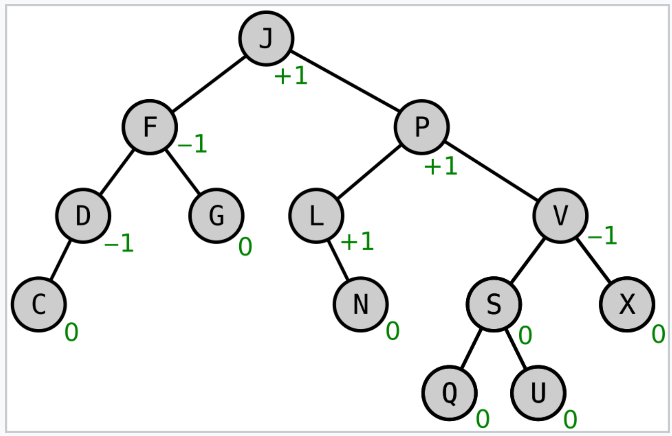
AVL Tree
Self-Balancing BST
Core: Height difference between left and right subtrees ≤ 1 for each node
Balance Factor: height(left) - height(right) ∈ {-1, 0, 1}

Slide 12
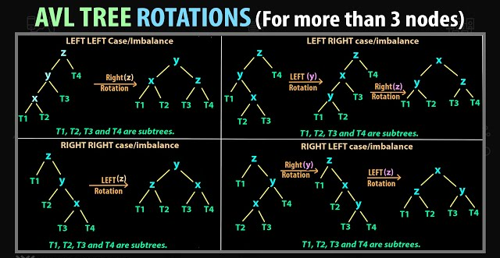
Self-Balancing BST
Core: Height difference between left and right subtrees ≤ 1 for each node
Balance Factor: height(left) - height(right) ∈ {-1, 0, 1}
Insert Operation
  Standard BST insertion
  Update heights of ancestor nodes
  Check balance factors
  If unbalanced, perform rotations:
    Left-Left: Right rotation
    Right-Right: Left rotation
    Left-Right: Left rotation + Right rotation
    Right-Left: Right rotation + Left rotation
Complexity: O(log n) (always balanced)

Slide 13
Delete Operation
Steps:
  Standard BST deletion
  Update heights upward from deletion point
  Check balance factor for each ancestor
  Perform rotations if needed (up to O(log n) times)
Complexity: O(log n)
AVL Advantages and Limitations
  Advantages: Strict balance, excellent query performance
  Limitations: Frequent rotations, high insertion/deletion cost

Slide 14
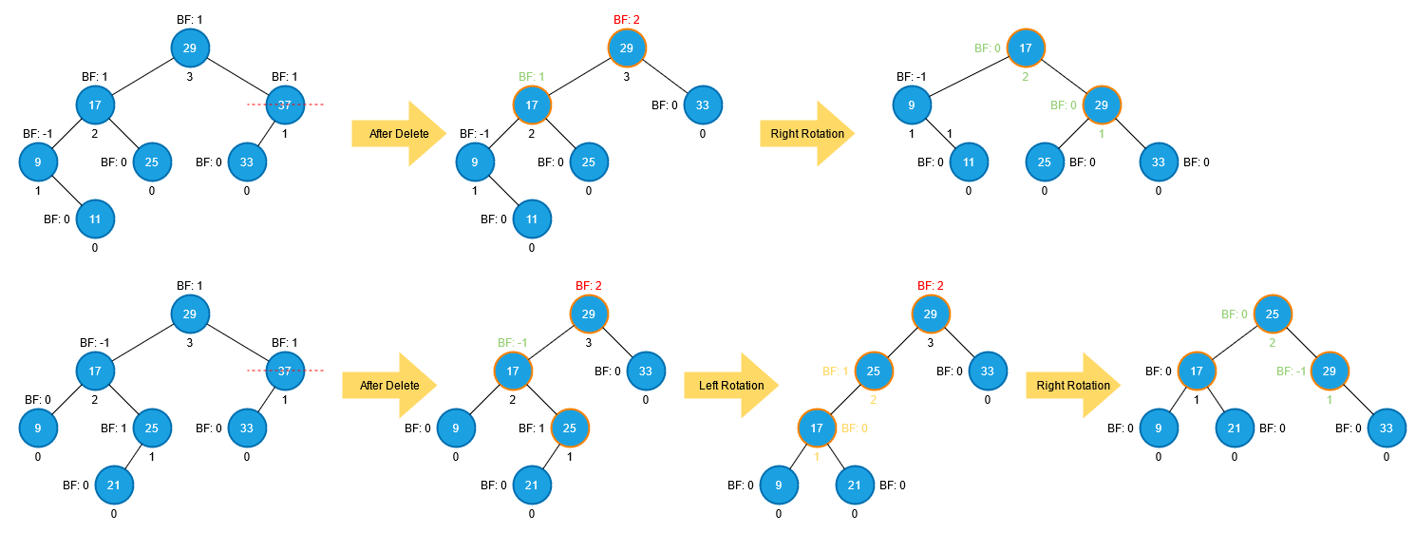

Slide 15
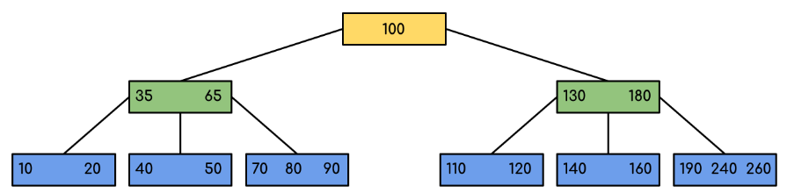
B-tree
Design Goals
  Reduce disk I/O
  Suitable for large-scale data
  Multiway balanced search tree
Structural Properties
B-tree of order m:
  Root node: 2 to m children
  Internal nodes: ⌈m/2⌉ to m children
  All leaves at same level
  Node contains k keys and k+1 child pointers

Slide 16
Insert Operation
Steps:
  Find insertion position (leaf node)
  If leaf not full → Insert directly
  If leaf is full:
    Split node (middle key moves up)
    Recursively split upward
    May increase tree height
Complexity: O(log_m n) disk accesses

Slide 17
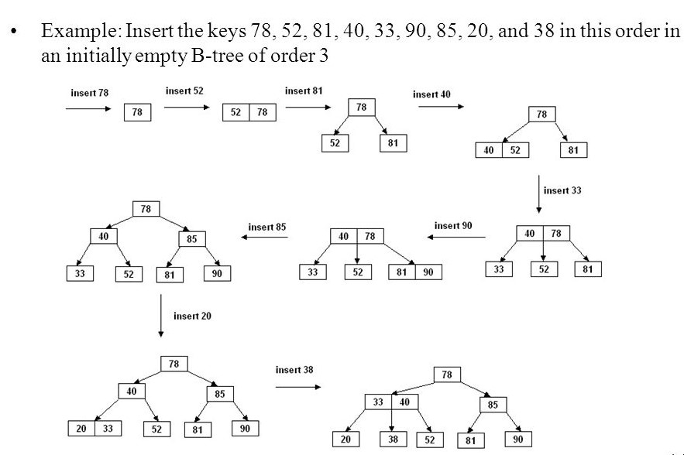

Slide 18
Delete Operation
Complex Case Handling:
Delete from leaf:
  Direct deletion (if at least ⌈m/2⌉-1 keys remain)
  Otherwise borrow key from sibling
  Or merge with sibling
Delete from internal node:
  Replace with predecessor/successor
  Recursively delete predecessor/successor
Complexity: O(log_m n)

Slide 20
B+ Tree
Database Indexing Standard
Key Differences from B-tree:
  Data stored only in leaf nodes
  Leaf nodes form linked list
  Internal nodes store only keys (no data)
Structural Advantages
  Faster range queries
  Higher fanout (more child nodes)
  Optimized sequential access

Slide 21
Insert Operation
Steps:
Find corresponding leaf node
If leaf not full → Insert in order
If leaf is full:
  Split leaf node
  Copy middle key to parent
  Update leaf linked list pointers
Complexity: O(log_f n), where f is fanout

Slide 22
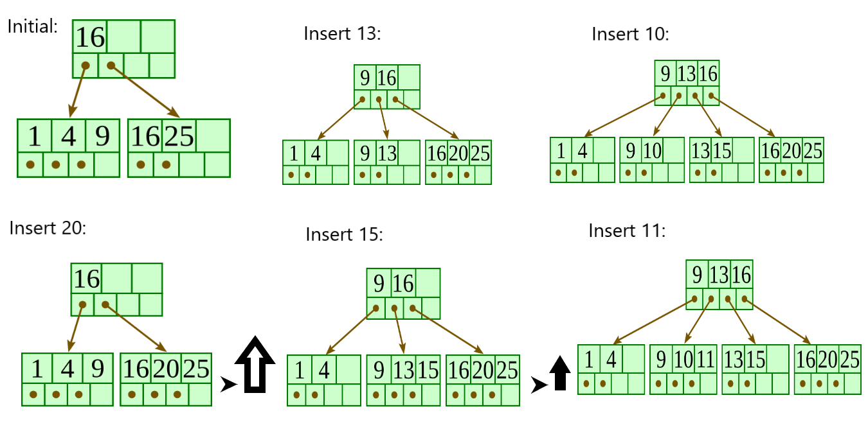

Slide 23
Delete Operation
Steps:
  Delete key from leaf node
  If leaf node underflows:
    Attempt redistribution from sibling
    Or merge with sibling node
  Update parent node keys
Note: Deletion may propagate to root

Slide 24
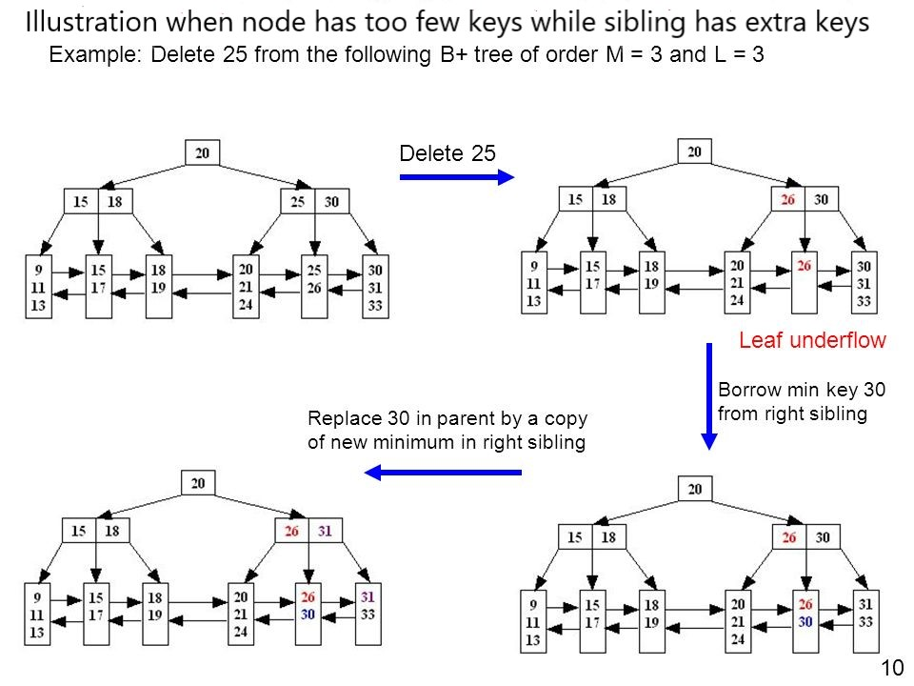

Slide 25
Insert/Delete Complexity Comparison
Time Complexity
Disk I/O Complexity
Key Insight: B-tree/B+ Tree have larger log base, significantly reducing disk access
Structure | Insert | Delete | Balance Maintenance
BST | O(n)-O(log n) | O(n)-O(log n) | None
AVL | O(log n) | O(log n) | Strict, frequent
B-tree | O(log_m n) | O(log_m n) | Node split/merge
B+ Tree | O(log_f n) | O(log_f n) | Similar to B-tree
Structure | Insert | Delete | Practical Consideration
BST/AVL | High | High | Suitable for memory
B-tree | O(log_m n) | O(log_m n) | m typically 100-200
B+ Tree | O(log_f n) | O(log_f n) | f typically 200-500

Slide 26
Why Concurrency Control?
Advantages of Concurrent Transactions
  ✅ Increased System Throughput: Full utilization of system resources
  ✅ Reduced Wait Times: Users don't wait sequentially
  ✅ Improved Resource Utilization: Parallel CPU and I/O operations
Challenges Brought by Concurrency
  ❌ Risk of Data Inconsistency
  ❌ Violation of Transaction ACID Properties
  ❌ Unpredictable Results
The Importance of Isolation
  "Isolation ensures concurrently executing transactions appear as if they executed serially"

Slide 27
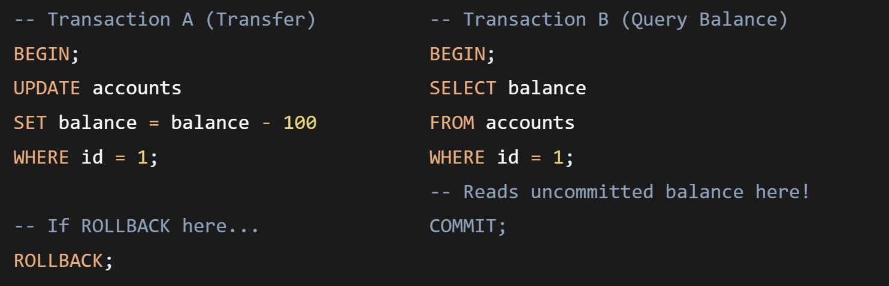
Problem One: Dirty Read
What is a Dirty Read?
  Definition: Transaction A reads data modified by Transaction B that is uncommitted
  Key Characteristic: The read data may be rolled back, never truly existing
Scenario Simulation
Result: Transaction B sees data that never truly happened
Harm Analysis
  Business decisions based on erroneous data
  Complete breakdown of data consistency
  Violates the basic atomicity of transactions

Slide 28
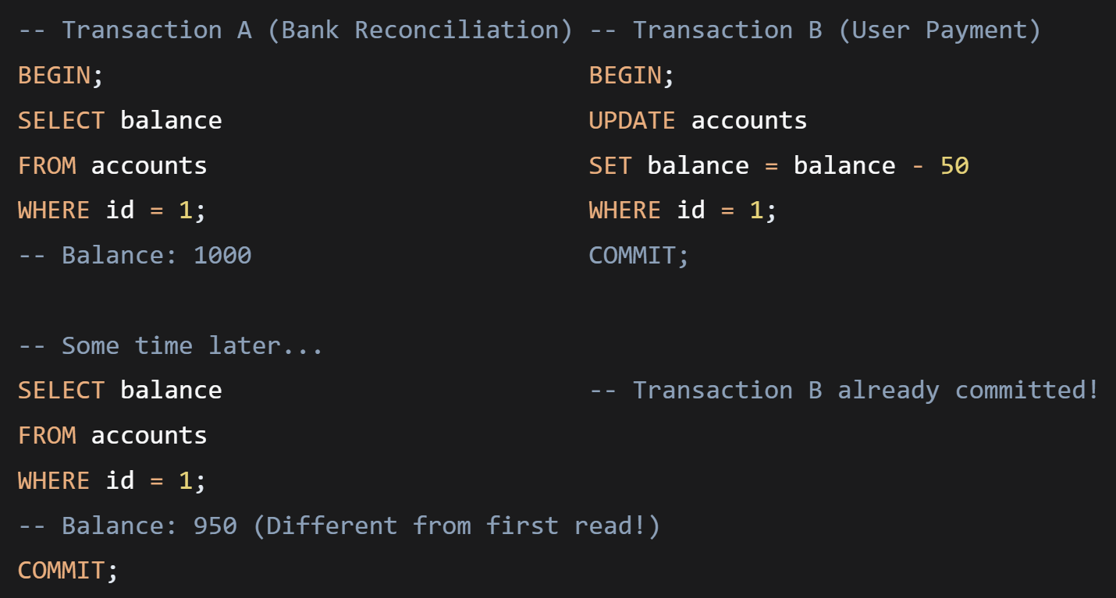
Problem Two: Non-repeatable Read
What is a Non-repeatable Read?
  Definition: Within the same transaction, two reads of the same data yield different results
  Key Characteristic: Data is modified and committed by another transaction during the transaction's execution
Scenario Simulation
Result: Transaction A sees external changes during its own execution
Harm Analysis
  Logical judgments within the same transaction become invalid
  Inaccurate statistical calculations
  Violates business requirements for "repeatable reads"

Slide 29
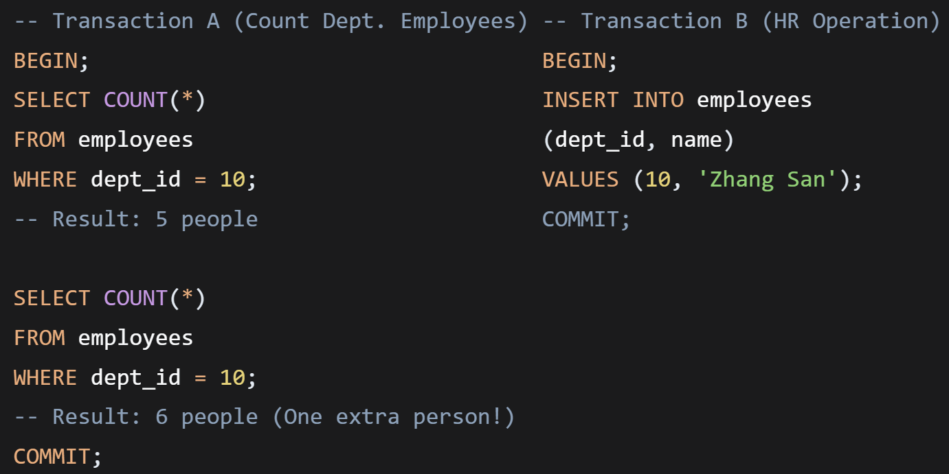
Problem Three: Phantom Read
What is a Phantom Read?
  Definition: Within the same transaction, two identical range queries return a different number of rows
  Key Characteristic: Other transactions insert or delete data within the range
Scenario Simulation
Result: Transaction A sees rows that "magically appear" or "mysteriously disappear"
Difference from Non-repeatable Read
Aspect | Non-repeatable Read | Phantom Read
Target | Existing rows | New rows
Operation | UPDATE | INSERT/DELETE
Focus | Data content change | Data set change

Slide 30
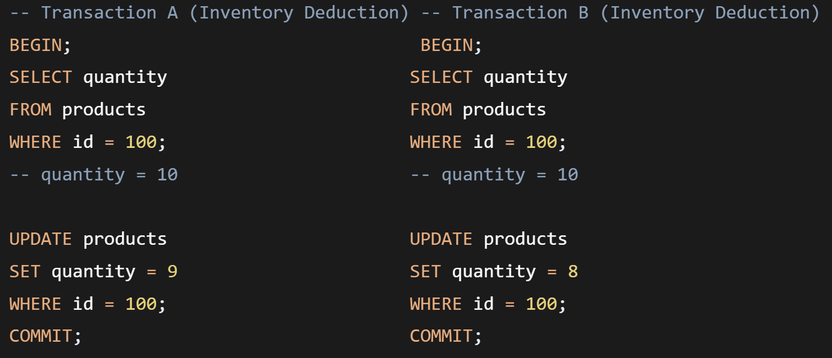
Problem Four: Lost Update
What is a Lost Update?
  Definition: Two transactions modify the same data simultaneously, with the later commit overwriting the earlier one
  Key Characteristic: The earlier commit's modifications are "silently" lost
Scenario Simulation
Final Result: quantity = 8 (Transaction A's deduction is completely overwritten)
Two Types of Lost Update
  First Lost Update (Rollback Overwrite)
    Transaction A overwrites Transaction B's update upon rollback
    Mostly solved in modern databases
  Second Lost Update (Commit Overwrite)
    Later-committing transaction overwrites earlier-committing transaction
    Most common business problem

Slide 31
Solution Framework: Isolation Levels
Problems Solved at Each Level
*Note: Most databases also prevent phantom reads at Repeatable Read level (e.g., MySQL InnoDB)
Isolation Level | Dirty Read | Non-repeatable Read | Phantom Read | Performance
Read Uncommitted | ❌ Allowed | ❌ Allowed | ❌ Allowed | ⭐⭐⭐⭐⭐
Read Committed | ✅ Prevented | ❌ Allowed | ❌ Allowed | ⭐⭐⭐⭐
Repeatable Read | ✅ Prevented | ✅ Prevented | ❌ Allowed* | ⭐⭐⭐
Serializable | ✅ Prevented | ✅ Prevented | ✅ Prevented | ⭐

Slide 32
Summary and Best Practices
Core Principles Review
  No Perfect Solution: Trade-off between isolation and performance
  Understand Business Requirements: Choose isolation level based on application scenario
  Know Database Characteristics: Different databases have different implementations
Isolation Level Selection Guide
  Data Warehouse/Reporting Systems → READ UNCOMMITTED or READ COMMITTED
  Most OLTP Applications → READ COMMITTED (balanced choice)
  Financial/Accounting Systems → REPEATABLE READ or SERIALIZABLE
  Requiring Highest Consistency → SERIALIZABLE (consider performance impact)

Slide 33
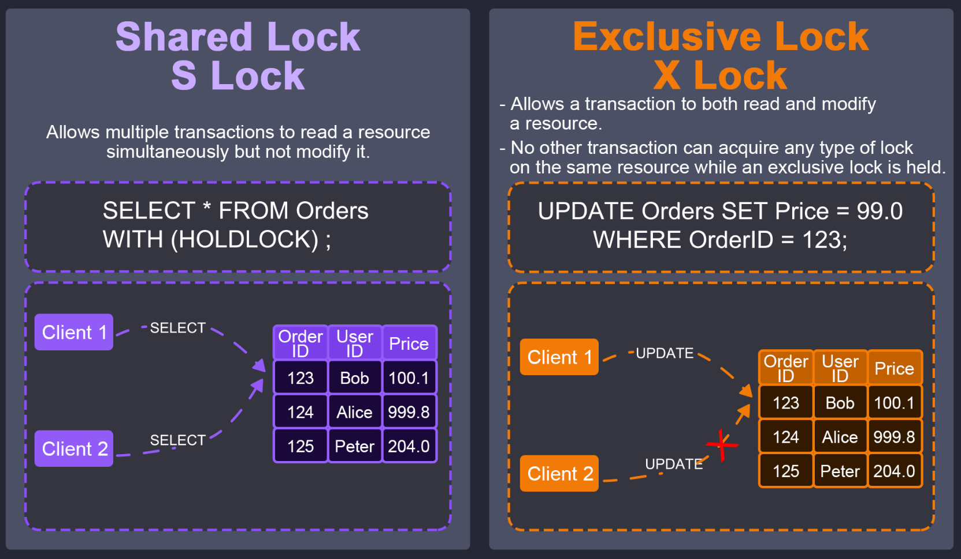
Core Mechanism: Locks*
Isolation is primarily achieved through locking:
  Shared Lock (S Lock): Read lock, allows concurrent reads
  Exclusive Lock (X Lock): Write lock, blocks all other access

Slide 34
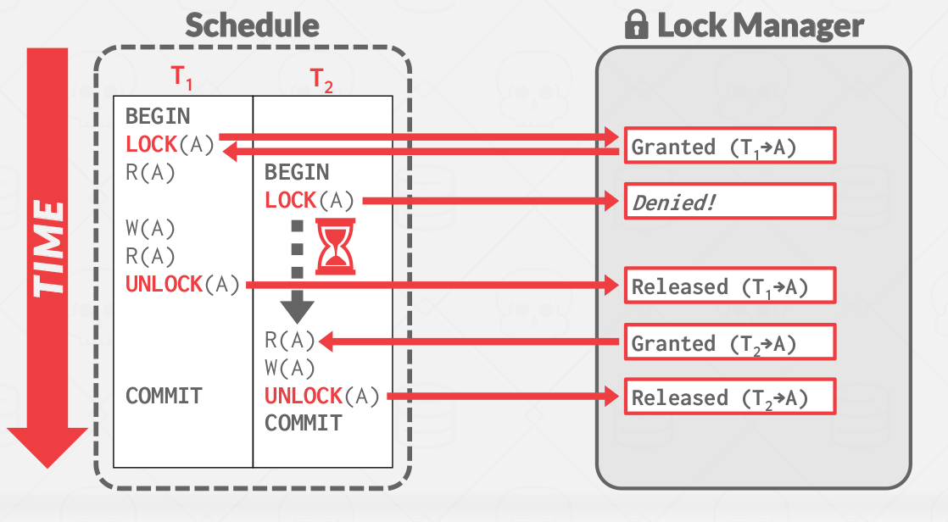
  Two-Phase Locking (2PL): Acquire phase → release phase

Slide 35
Core Mechanism: MVCC (Multi-Version Concurrency Control)*
  Each write creates a new row version
  Reads obtain a “snapshot,” so they don’t block writes
  Write-write conflicts still require locks
  Used in PostgreSQL, MySQL InnoDB, Oracle, etc.
Pros: Read–write operations rarely block
Cons: Old versions must be cleaned up (GC / Vacuum)

Slide 36
How Read Uncommitted Is Implemented*
Characteristics: Allows reading uncommitted data
Implementation:
  Reads do not take S locks
  Reads may view the latest version directly
  Writes take X locks but do not block reads

Slide 37
How Read Committed Works*
Goal: Prevent Dirty Reads
Implementation:
  Each SELECT reads the latest committed version (MVCC snapshot)
  A new snapshot is taken for every statement
  Writes hold X locks until commit
Outcome:
  No Dirty Reads
  But Non-repeatable Reads can occur

Slide 38
Repeatable Read Implementation*
Goal: Data read once remains stable
Implementation varies by DBMS:
  MySQL InnoDB (Important Case)
  Snapshot created at transaction start
  All SELECTs read from the same snapshot

Slide 39
How Serializable Is Implemented*
Strictest level
Common approaches:
Strict Two-Phase Locking (2PL)
  All reads/writes acquire locks
Prevents all anomalies
But significantly reduces concurrency

Slide 40

Bye~

